Slide 1

Trader Joe’s NYC Growth Strategy
Identifying Possible Locations for New Stores

Slide 2
Growth Strategy Components
Customer Profile
Current Strategy
Alternative Strategy (Increase TAM)

Slide 3
Data
Open/Public Data
NYC Open Data
Data.NY.Gov
Data.Gov
Trader Joe's Website

Slide 4
Current Store Layout
High density in Manhattan
Few stores in Brooklyn, Queens, Staten Island
No stores in the Bronx

Slide 5
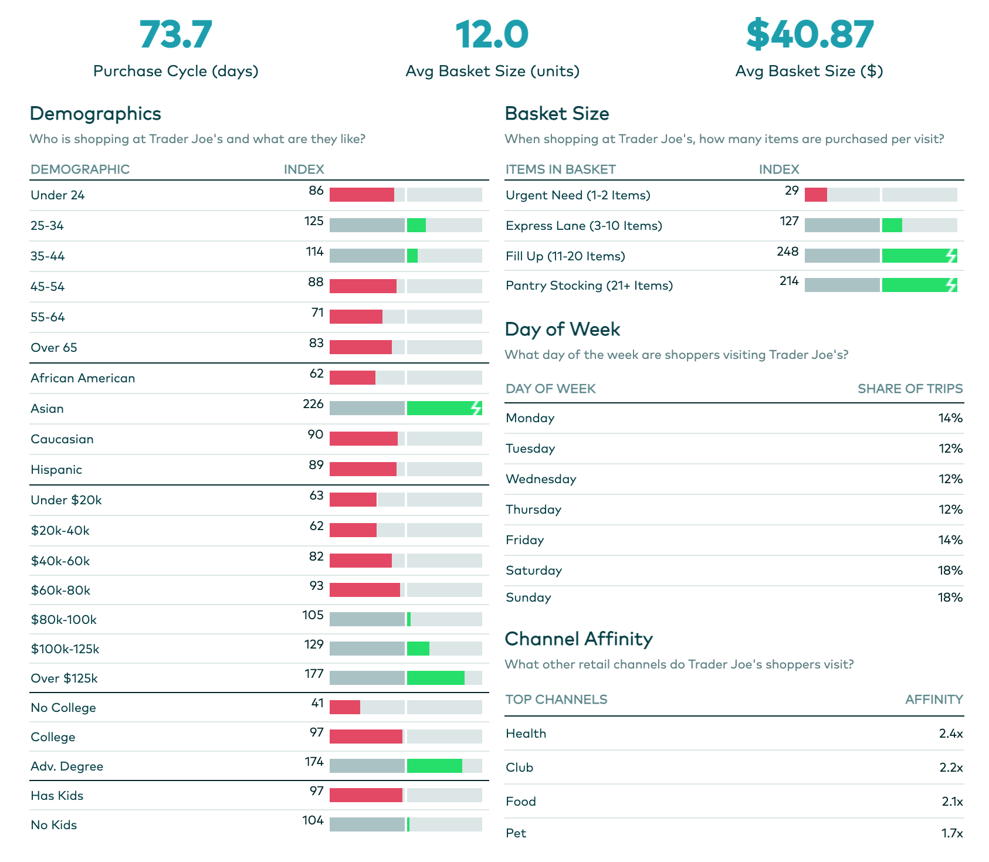
Customer Profile
Age
Income
Advanced Degree
Basket Size
https://snapshot.numerator.com/retailer/trader_joes

Slide 6
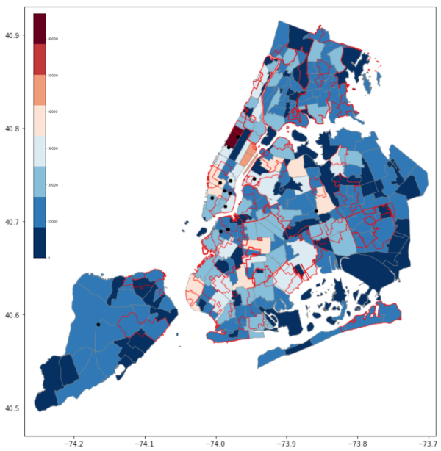
Key Considerations
Total Number of Households per NTA
Population
Demographics
Competitors
Under-served Communities
Latitude
Longitude

Slide 7
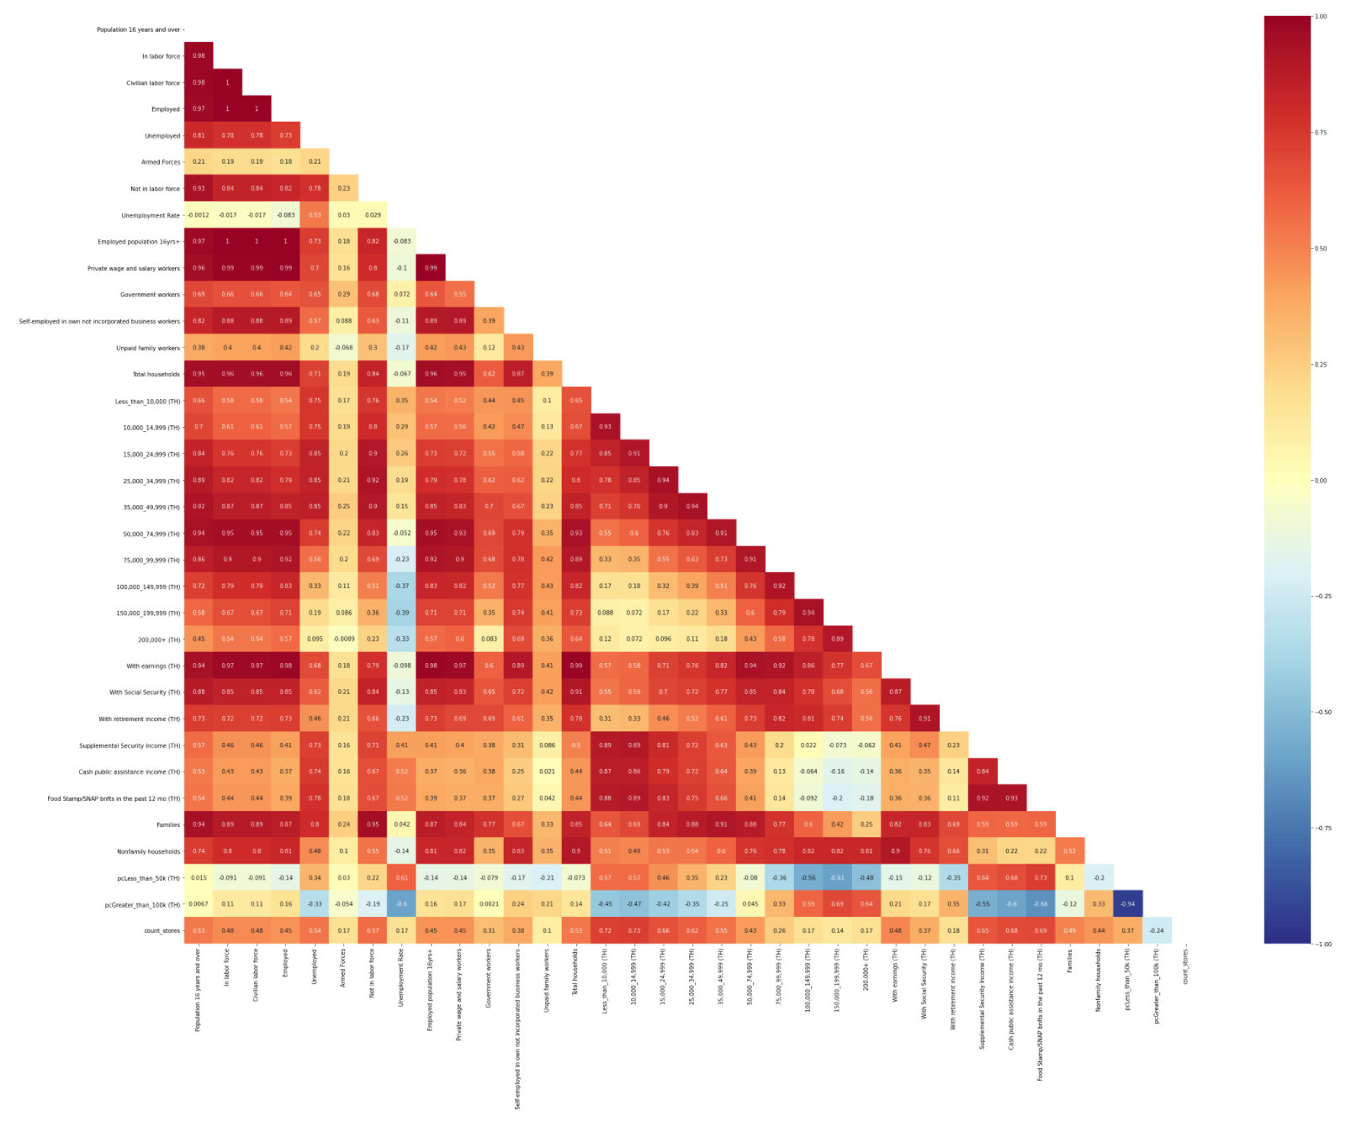
Growth Strategy Components
High degree of feature correlation
PCA to create independent features

Slide 8
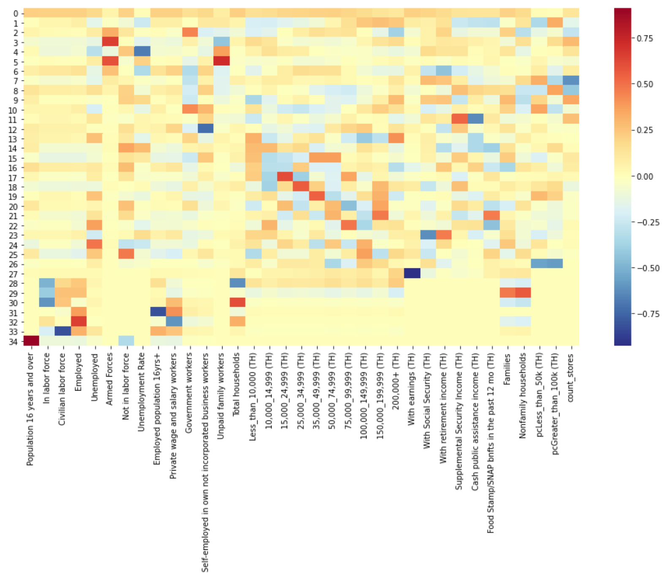
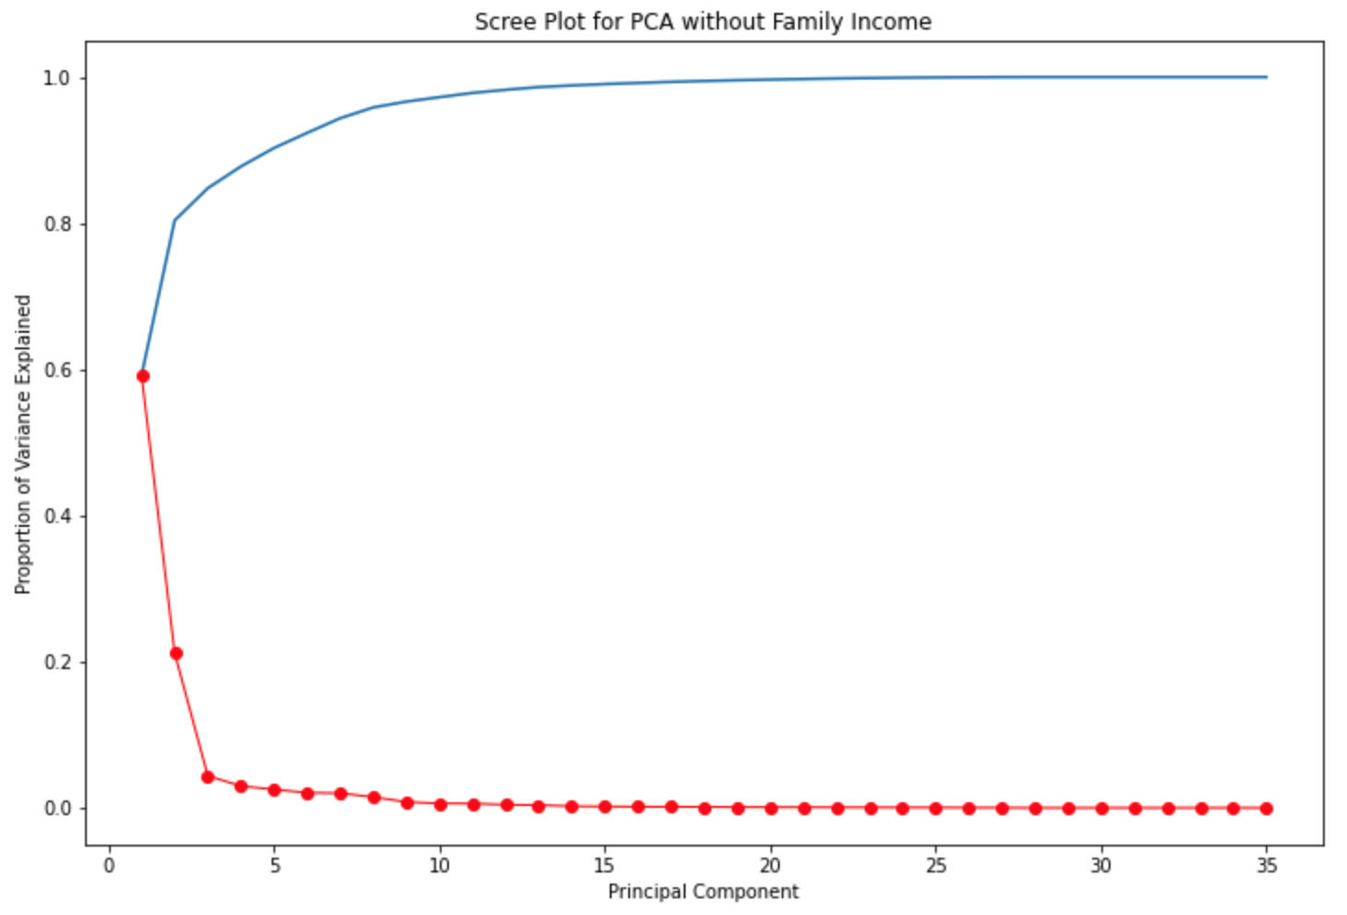
Principal Components Analysis

Slide 9
Principal Components Analysis
1st PC – Population
2nd PC - Income

Slide 10
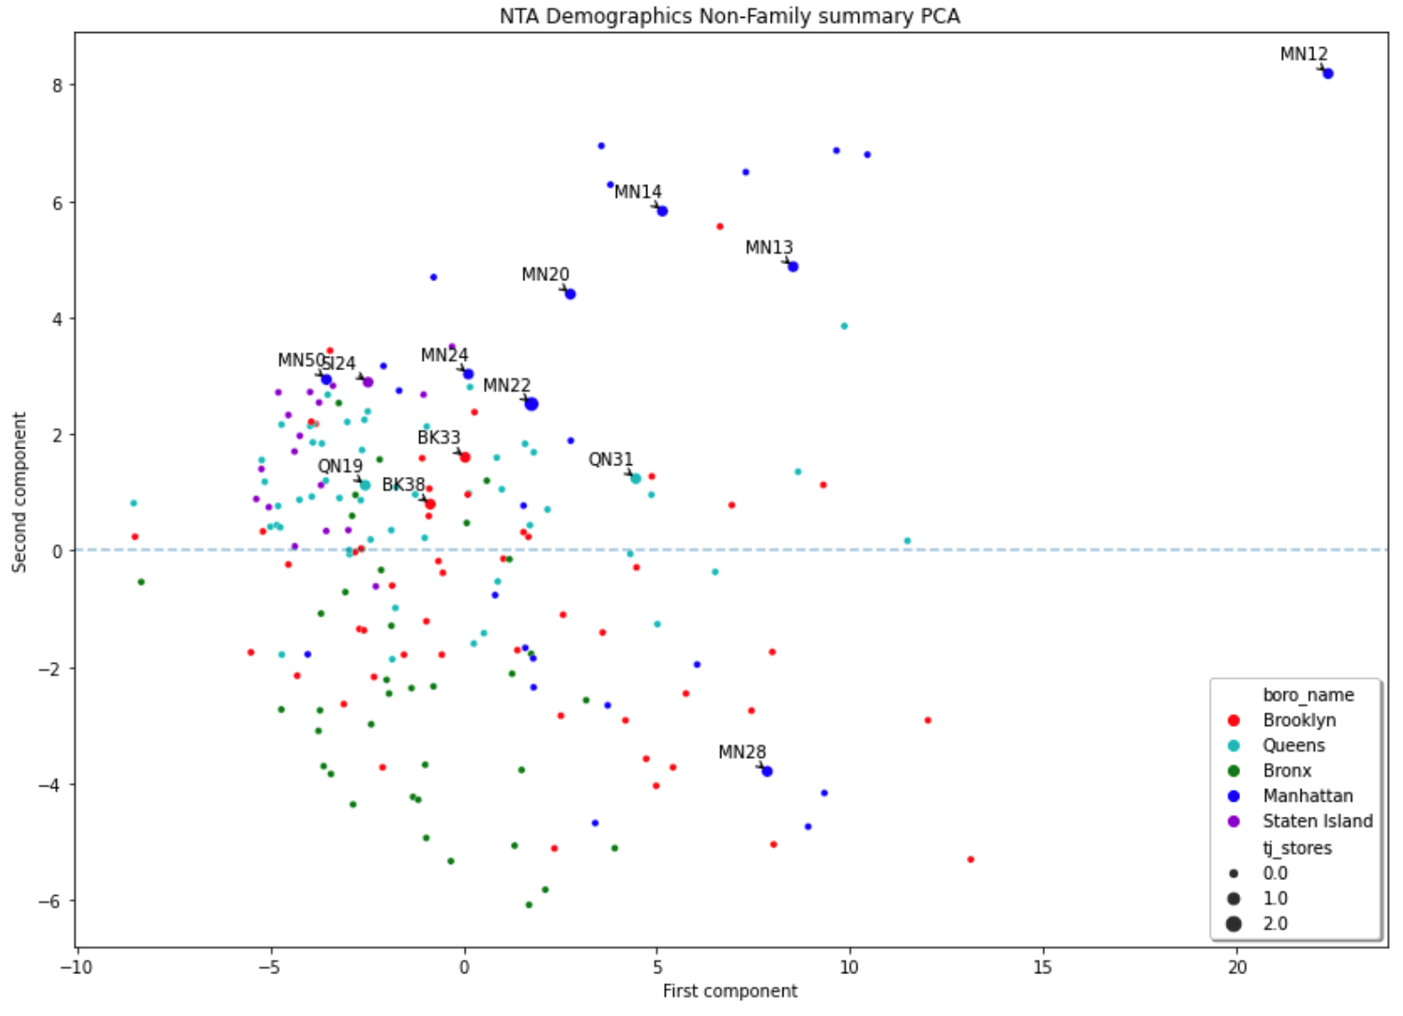
Principal Components and Trader Joe’s Stores
Population/Households
PC 1
CURRENT STRATEGY
High % above $100k
PC 2
Income
High % below $50k

Slide 11
Current Strategy Components

Slide 12
Principal Components and Trader Joe’s Stores
Population/Households
PC 1
High % above $100k
PC 2
Income
ALTERNATIVE STRATEGY?
High % below $50k

Slide 13
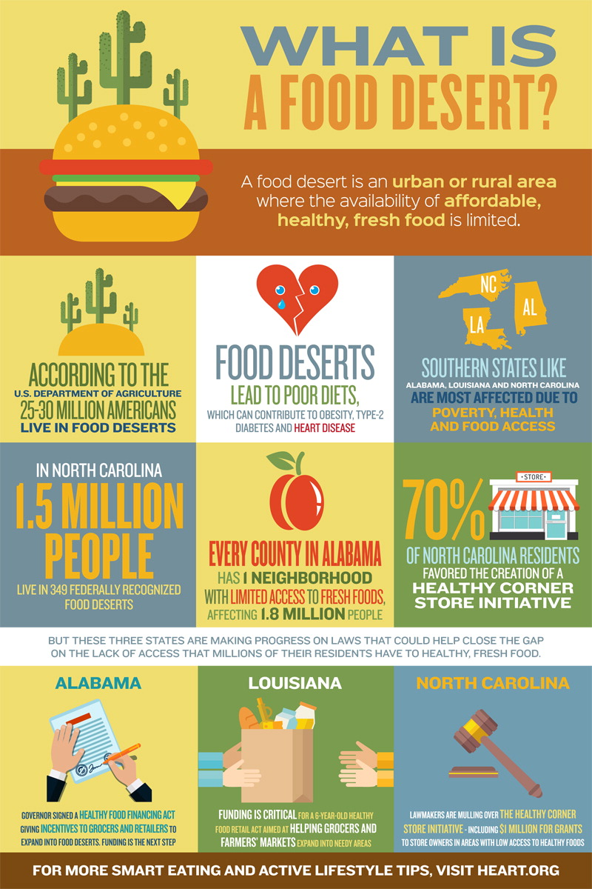

Food Deserts, Food Swamps
https://medium.com/@olivialimone/mapping-food-deserts-and-swamps-in-manhattan-and-the-bronx-46c6d8fc0804

Slide 14
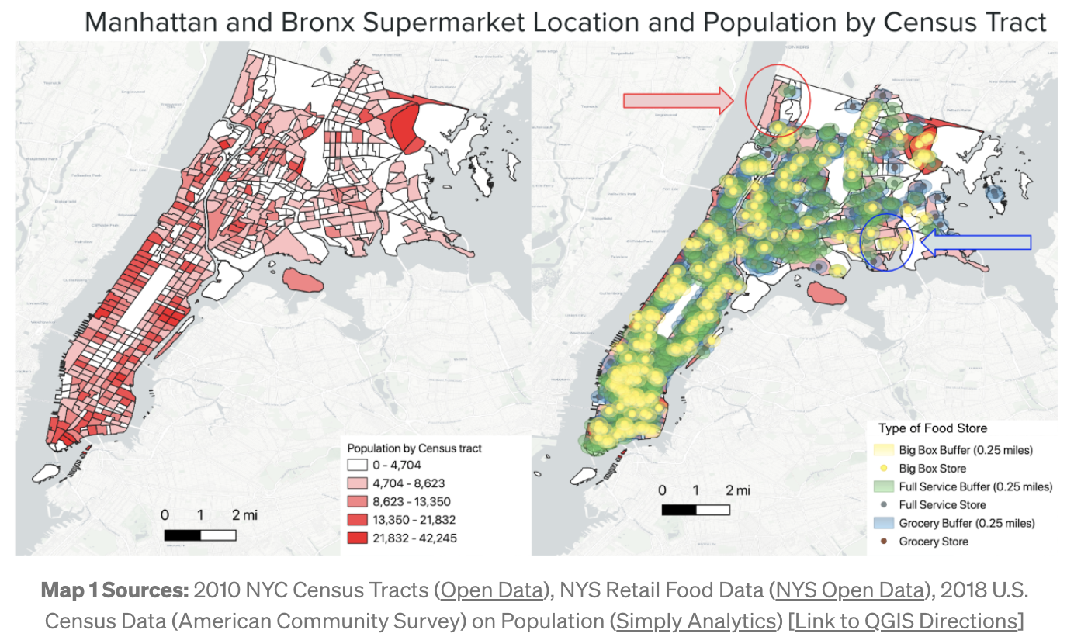
Food Deserts, Food Swamps
https://medium.com/@olivialimone/mapping-food-deserts-and-swamps-in-manhattan-and-the-bronx-46c6d8fc0804

Slide 15
Alternative Strategy (TAM Expansion)

Slide 16
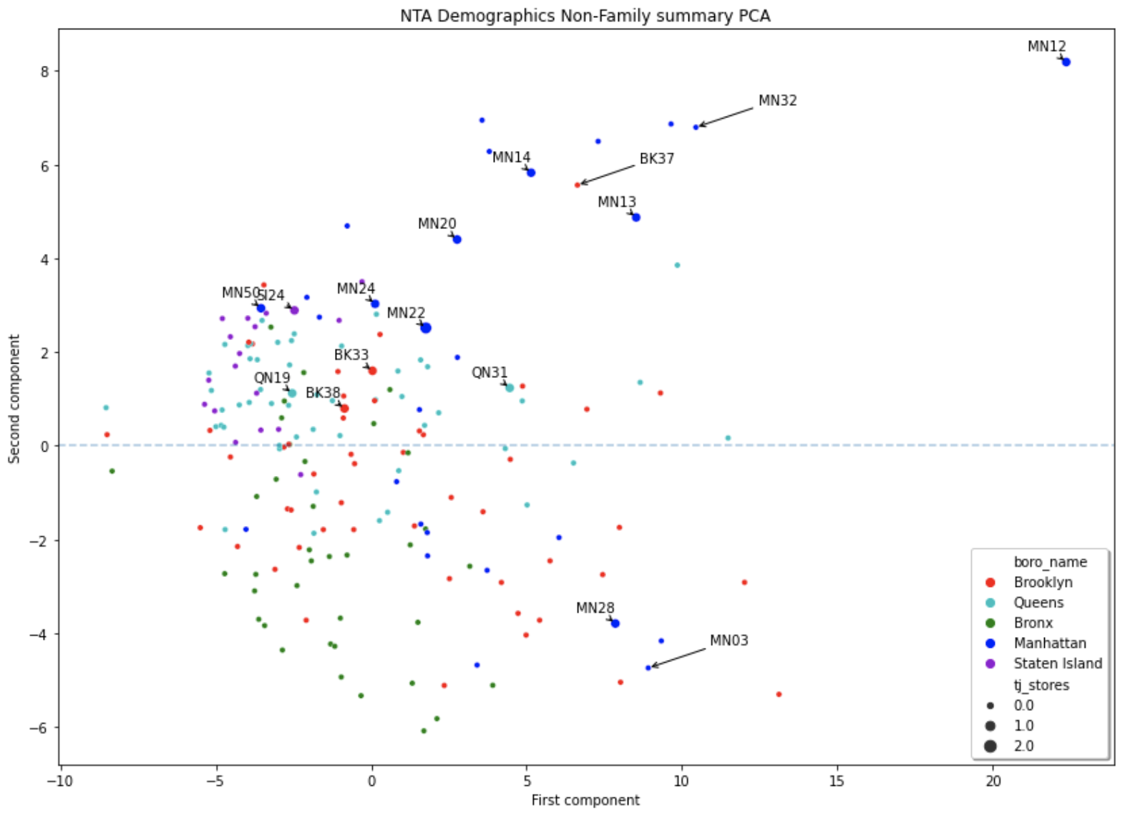
Growth Strategy Components
Long arrows identify store growth locations

Slide 17
Growth Strategy Summary
Current store strategy growth potential
Opportunity to grow TAM with new strategy

